Slide 1
PerfTest: Setup
Yoonki Song
Last Updated: Sep. 6, 2009

Slide 2
Outline
Download Packages from IBM Academic Initiative
WebSphere Application Server (WSAS) v6.1
Rational Performance Tester (RPT) v8.0
Install Packages on the Server side
WSAS v6.1
RPT Agent (with DCI) v8.0
Install Packages on the Client side
RPT (with Agent) v8.0

Slide 3
IBM Academic Initiative
Query: “WebSphere Application Server v6.1”
WebSphere Application Server V6.1 for Linux on x86Series Multilingual eAssembly (CR3ADML)
Part: WebSphere Application Server V6.1 for Linux on x86Series, 32-bit Support (C87QXML)
Part: WebSphere Application Server V6.1 Supplements Application Client, IBM HTTP Server, Web Server Plug-ins, Installation Factory, Migration Tool, IBM Support Assistant and Update Installer for Linux on x86Series, 32-bit Support Multilingual (C87PSML)
Part Information (in detail)
http://www-01.ibm.com/support/docview.wss?rs=180&uid=swg27007743

Slide 4
IBM Academic Initiative (Cont’d)
Query: “Rational Performance Tester V8.0”
IBM Rational Performance Tester V8.0 Multiplatform Multilingual eAssembly (Core) (CR7VNML) <- RPT Agent (Link Error?)
IBM Rational Performance Tester V8.0 for z/OS Multiplatform Multilingual eAssembly (Core) (CR7XFML) <- RPT (Link Error?)
Part Information (in detail)
http://www-01.ibm.com/support/docview.wss?rs=180&uid=swg27007743

Slide 5
WebSphere Application Server v6.1
Installation and Configuration on the Server side

Slide 6
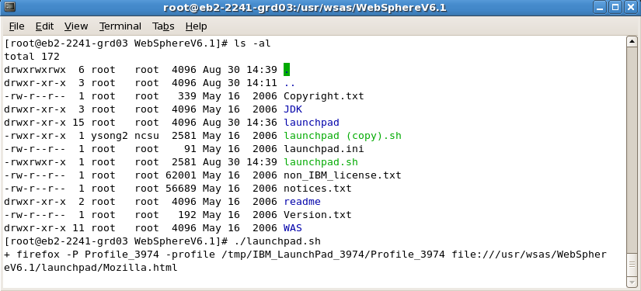
WSAS Installation
# ./launchpad.sh

Slide 7
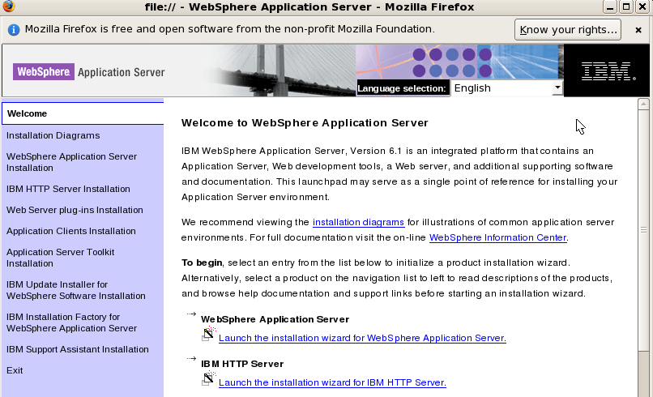
WSAS Installation (Cont’d)
Launch the installation wizard for WebSphere Application Server

Slide 8
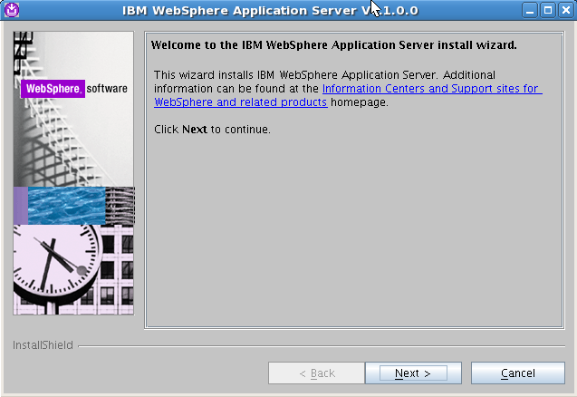
WSAS Installation (Cont’d)

Slide 9
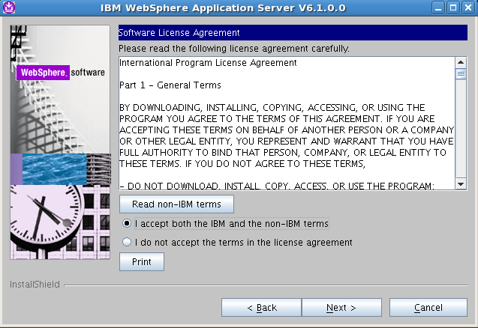
WSAS Installation (Cont’d)

Slide 10
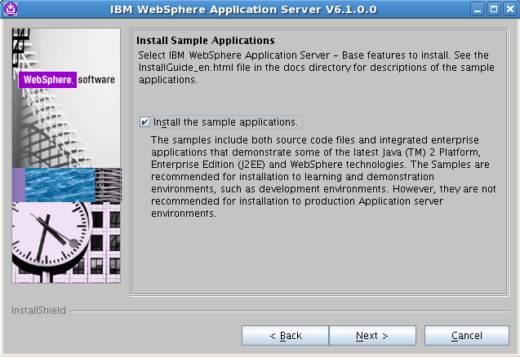
WSAS Installation (Cont’d)

Slide 11
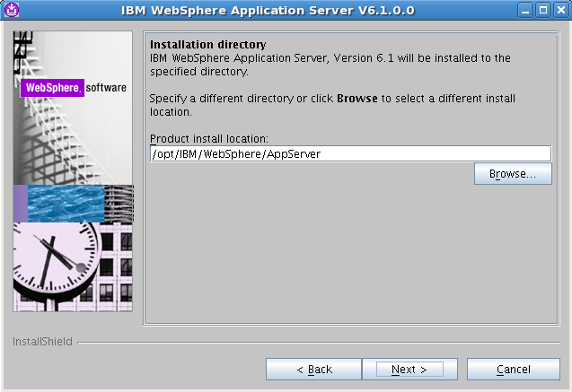
WSAS Installation (Cont’d)

Slide 12
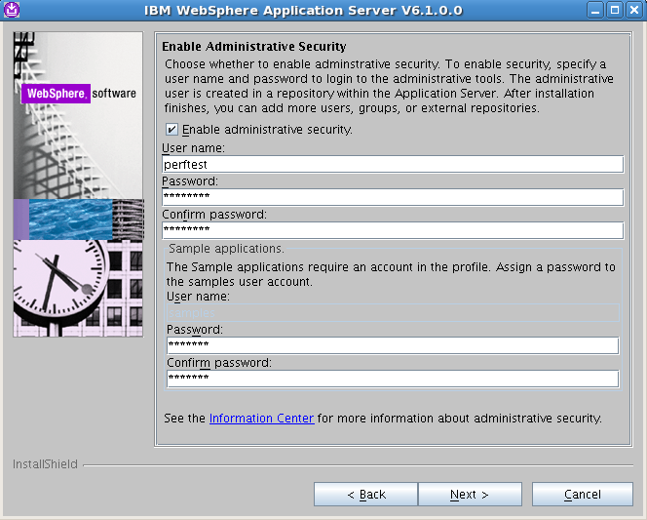
WSAS Installation (Cont’d)
perftest
perftest
perftest
samples
samples
samples

Slide 13
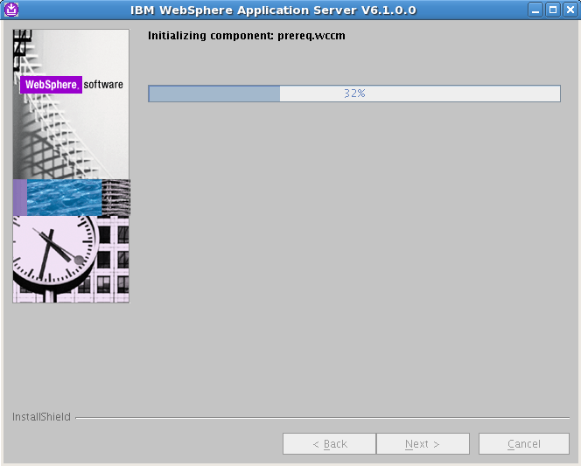
WSAS Installation (Cont’d)

Slide 14
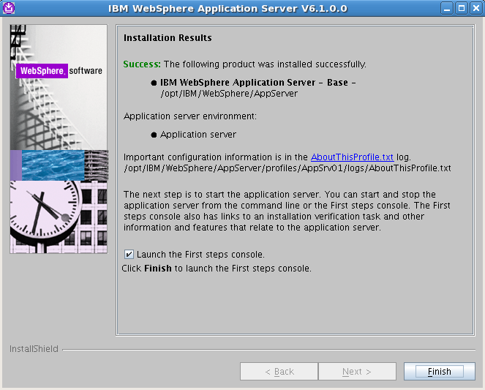
WSAS Installation (Cont’d)

Slide 15
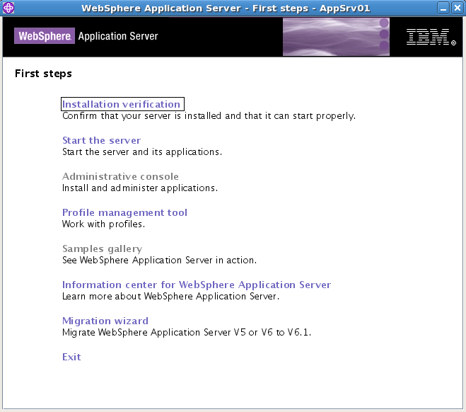
Installation Verification

Slide 16
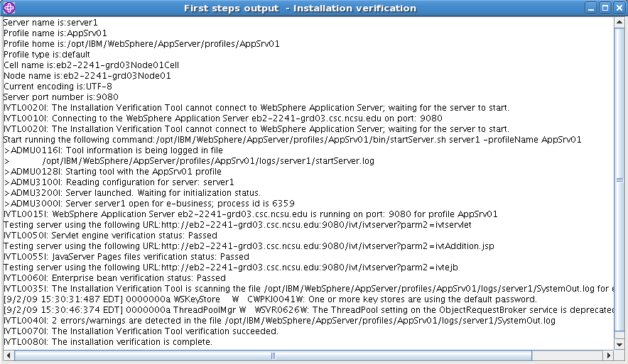
Installation Verification (Cont’d)

Slide 17
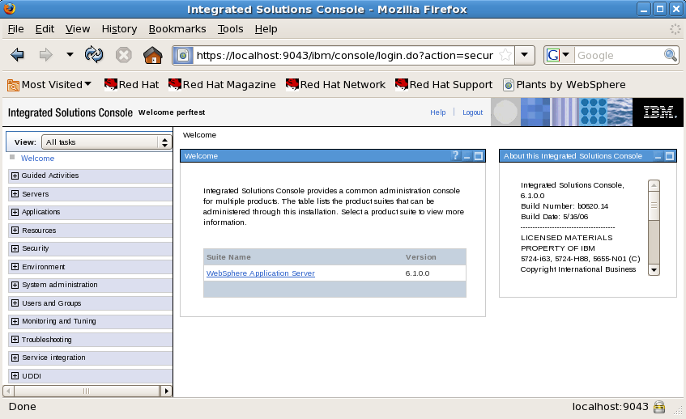
Administrative Console

Slide 18
Uninstallation (Optional)
Uninstall
/opt/IBM/WebSphere/AppServer/uninstall/uninstall -silent

Slide 19
IBM WebSphere Application Server commands
Start the IBM WebSphere Application server
/opt/IBM/WebSphere/AppServer/bin/startServer.sh server1
Stop the IBM WebSphere Application server
/opt/IBM/WebSphere/AppServer/bin/stopServer.sh server1
Check status of the IBM WebSphere Application Server
/opt/IBM/WebSphere/AppServer/bin/serverStatus.sh server1
Regenerate the Web server plug-in config file (which connects WAS to the Web Server)
/opt/IBM/WebSphere/AppServer/bin/GenPluginCfg.sh
Use the IBM WebSphere command line administration tool
/opt/IBM/WebSphere/AppServer/bin/wsadmin.sh

Slide 20
IBM HTTP Server v6.1
Installation and Configuration on the Server side

Slide 21
Installation
Launch the installation wizard for IBM HTTP Server

Slide 22
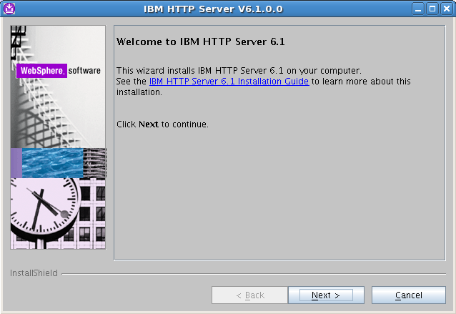
Installation

Slide 23
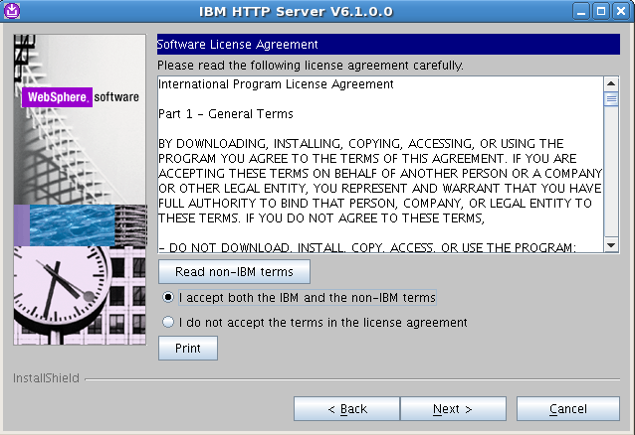
Installation (Cont’d)

Slide 24
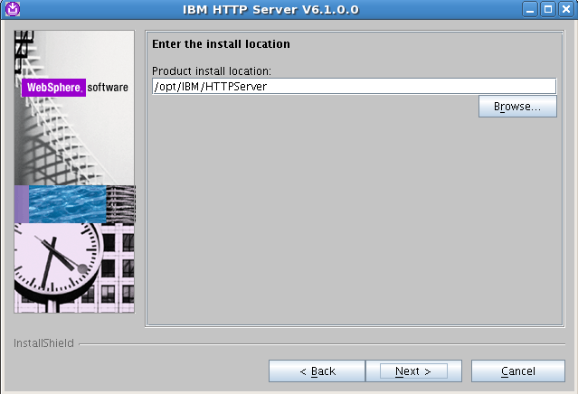
Installation (Cont’d)

Slide 25
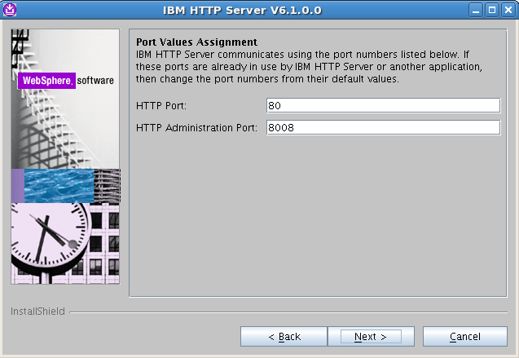
Installation (Cont’d)

Slide 26
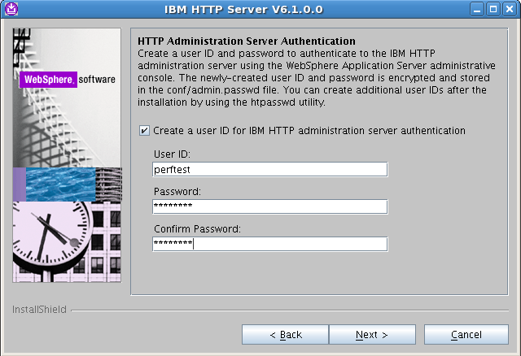
Installation (Cont’d)
perftest
perftest
perftest

Slide 27
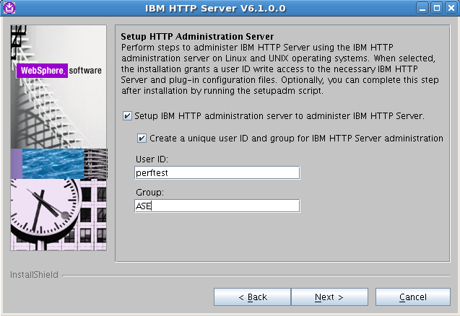
Installation (Cont’d)
perftest
ASE

Slide 28
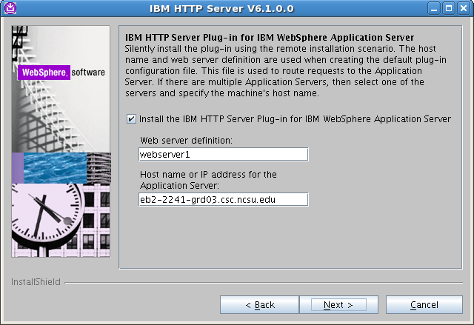
Installation (Cont’d)
webserver1
eb2-2241-grd03.csc.ncsu.edu

Slide 29
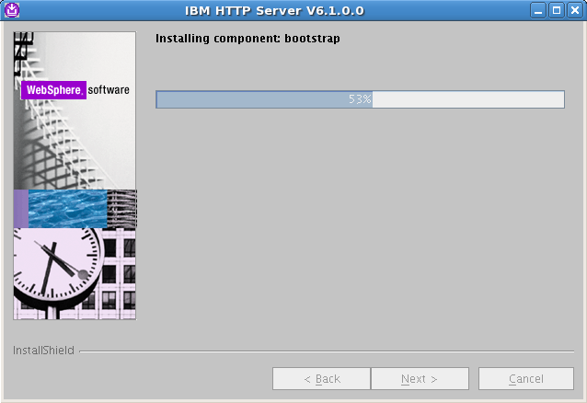
Installation (Cont’d)

Slide 30
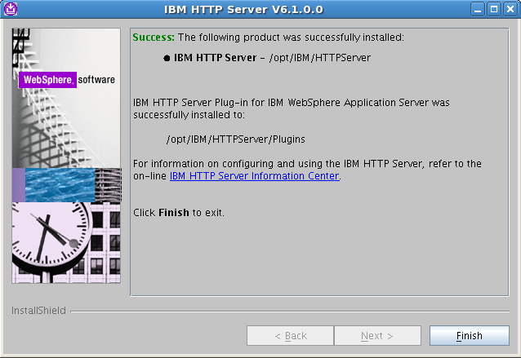
Installation (Cont’d)

Slide 31
IBM HTTP server commands
Start the IBM HTTP server
/opt/IBM/HTTPServer/bin/apachectl start
Stop the IBM HTTP server
/opt/IBM/HTTPServer/bin/apachectl stop
Start the IBM HTTP admin control service
/opt/IBM/HTTPServer/bin/adminctl start
Stop the IBM HTTP server admin control service
/opt/IBM/HTTPServer/bin/adminctl start

Slide 32
Uninstallation
/opt/IBM/HTTPServer/uninstall/uninstall

Slide 33
Web Server Plug-in
Installation and Configuration on the Server side

Slide 34
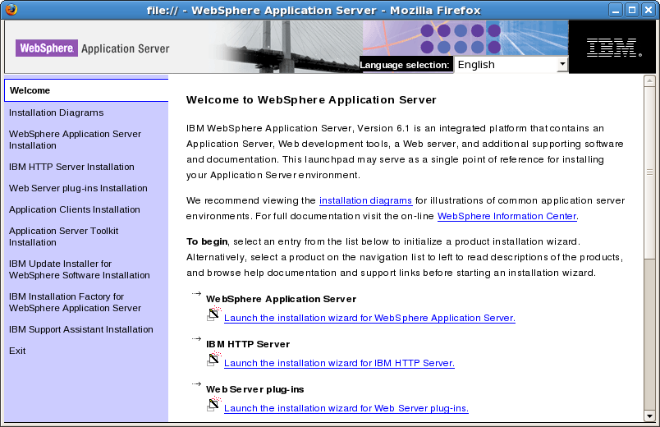
Installation

Slide 35
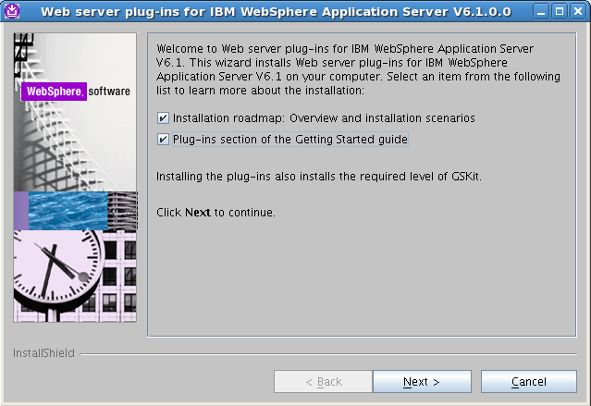
Installation (Cont’d)

Slide 36
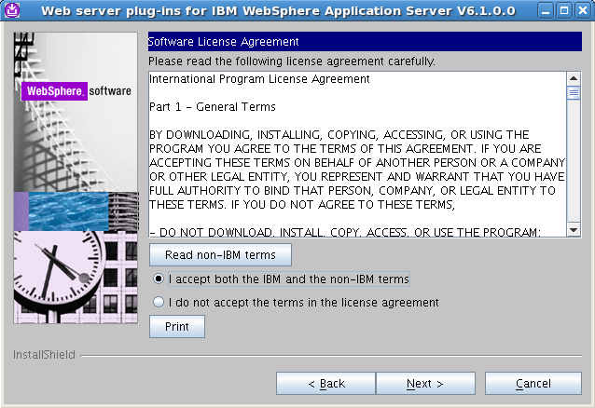
Installation (Cont’d)

Slide 37
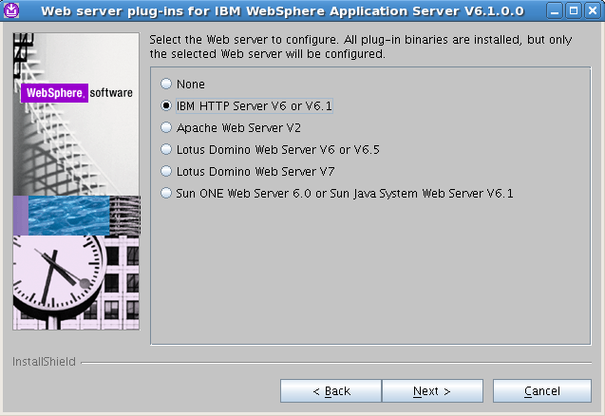
Installation (Cont’d)

Slide 38
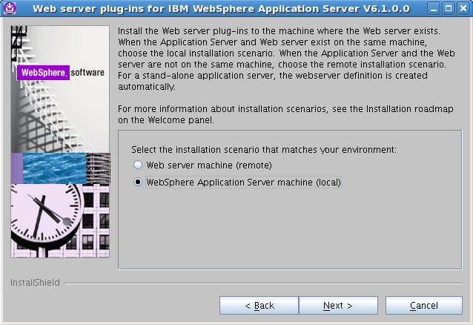
Installation (Cont’d)

Slide 39
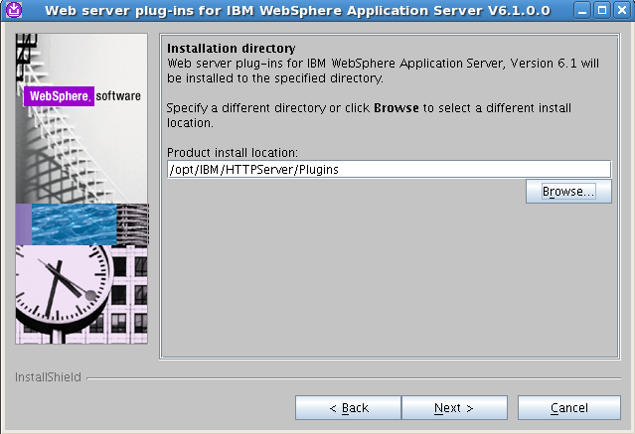
Installation (Cont’d)

Slide 40
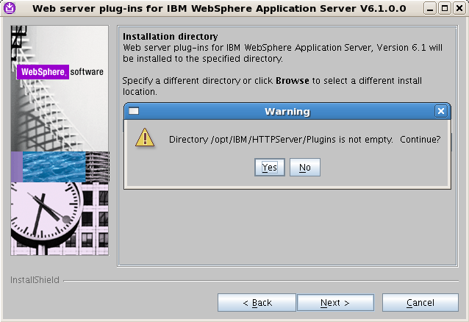
Installation (Cont’d)

Slide 41
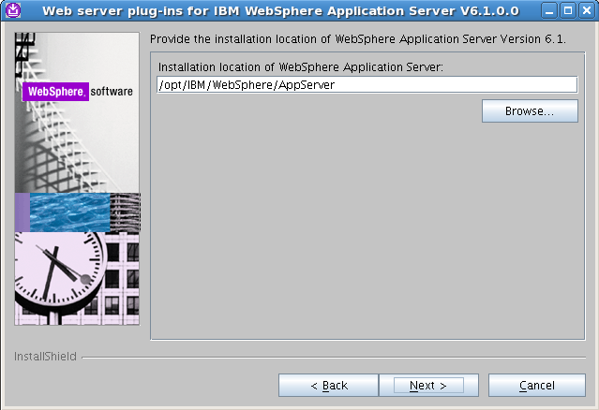
Installation (Cont’d)

Slide 42
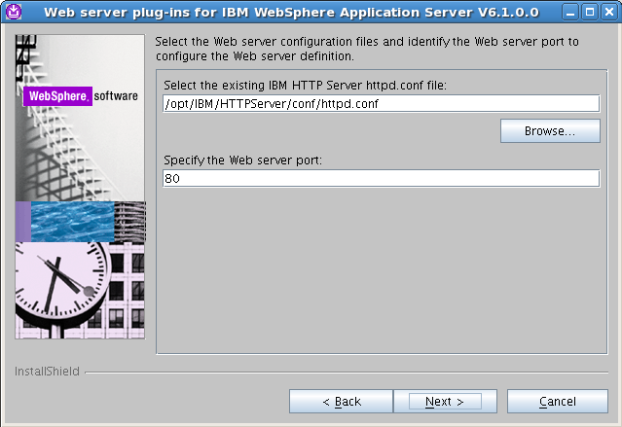
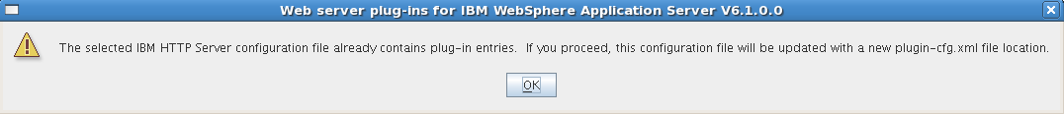
Installation (Cont’d)

Slide 43
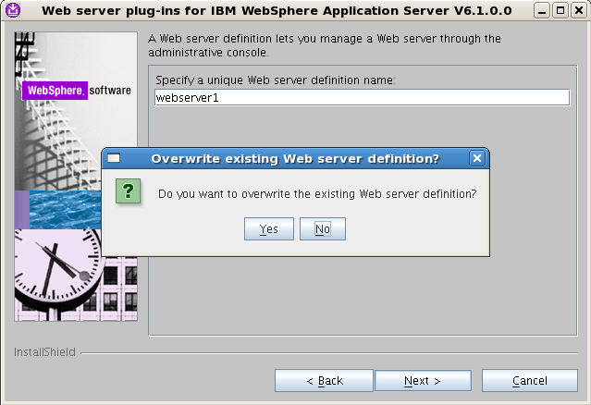
Installation (Cont’d)

Slide 44
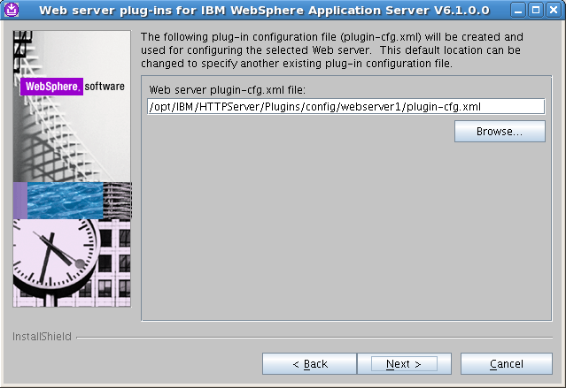
Installation (Cont’d)

Slide 45
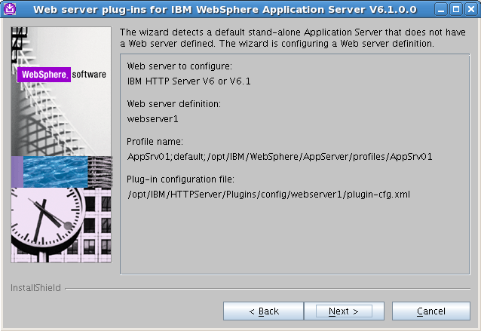
Installation (Cont’d)

Slide 46
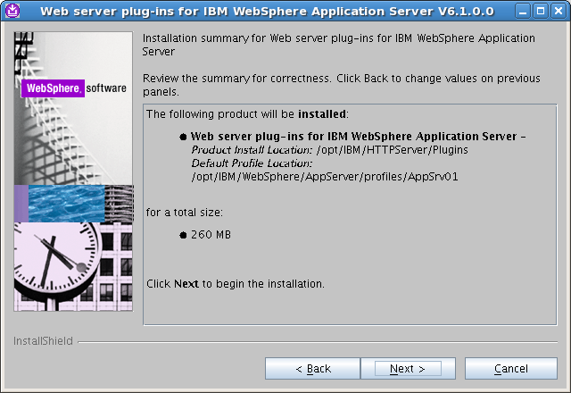
Installation (Cont’d)

Slide 47
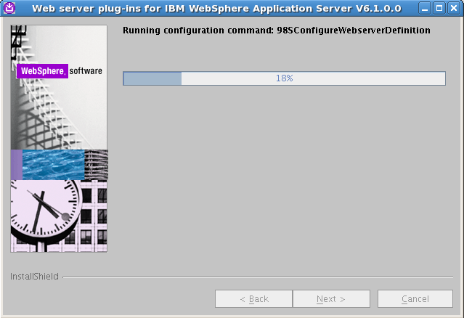
Installation (Cont’d)

Slide 48
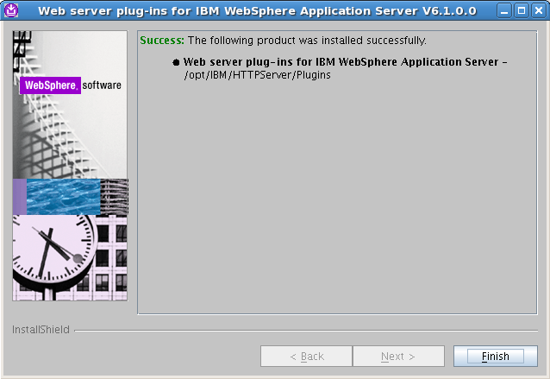
Installation (Cont’d)

Slide 49
Using WSAS Administrative Console
Check the status of the application server:
/opt/IBM/WebSphere/AppServer/bin/serverStatus.sh server1
If the status replies that the Application server “server1” is not started:
/opt/IBM/WebSphere/AppServer/bin/startServer.sh server1
Start Firefox in the background:
firefox &
To open the administrative console, enter the URL:
http://localhost:9090/admin

Slide 50
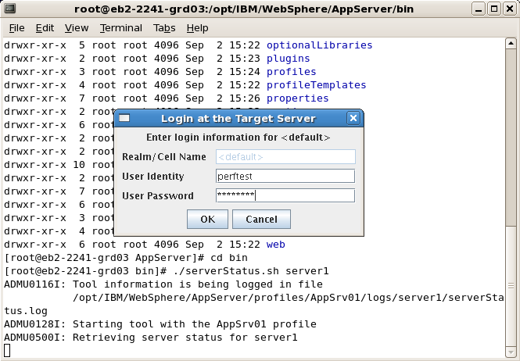
Starting WSAS
perftest
perftest

Slide 51
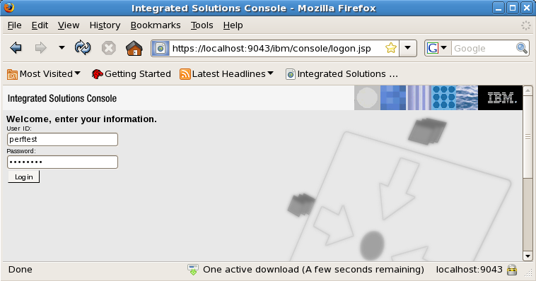
Starting WSAS
perftest
perftest

Slide 52
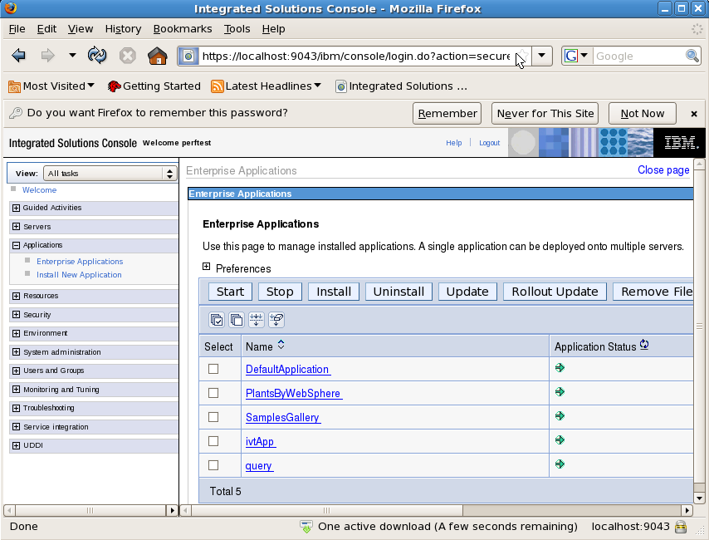
Starting WSAS
[Source Code] /opt/IBM/WebSphere/AppServer/samples/src/PlantsByWebSphere

Slide 53
Starting WSAS
Start the AC on the server
/opt/IBM/SDP/AgentController/bin/ACStart.sh
…

Slide 54
Trouble Shooting
ADMU3011E: Server fails to start on Linux platforms
http://www-01.ibm.com/support/docview.wss?uid=swg21287231
JVMJ9VM011W: Unable to load piAgent
http://www-01.ibm.com/support/docview.wss?uid=swg21288832 (Bad)
http://www-01.ibm.com/support/docview.wss?rs=180&uid=swg21246403 (Bad)

Slide 55
Export LD_LIBRARY_PATH
export
LD_LIBRARY_PATH=/usr/local/lib:${LD_LIBRARY_PATH}
To permanently set it for all users.
$ su -
Password:
# cd
/etc/ld.so.conf.d
# echo /usr/local/lib >local.conf
# exit

Slide 56
Agent Controller
Installation and Configuration on the Server side

Slide 57
Repository
/usr/rptagent
Installation Directory
/opt/IBM/SDP/AgentController
Starting AC
# /opt/IBM/SDP/AgentController/bin/ACStart.sh

Slide 58
Rational Performance Tester v8.0
Installation and Configuration on the Client side

Slide 59
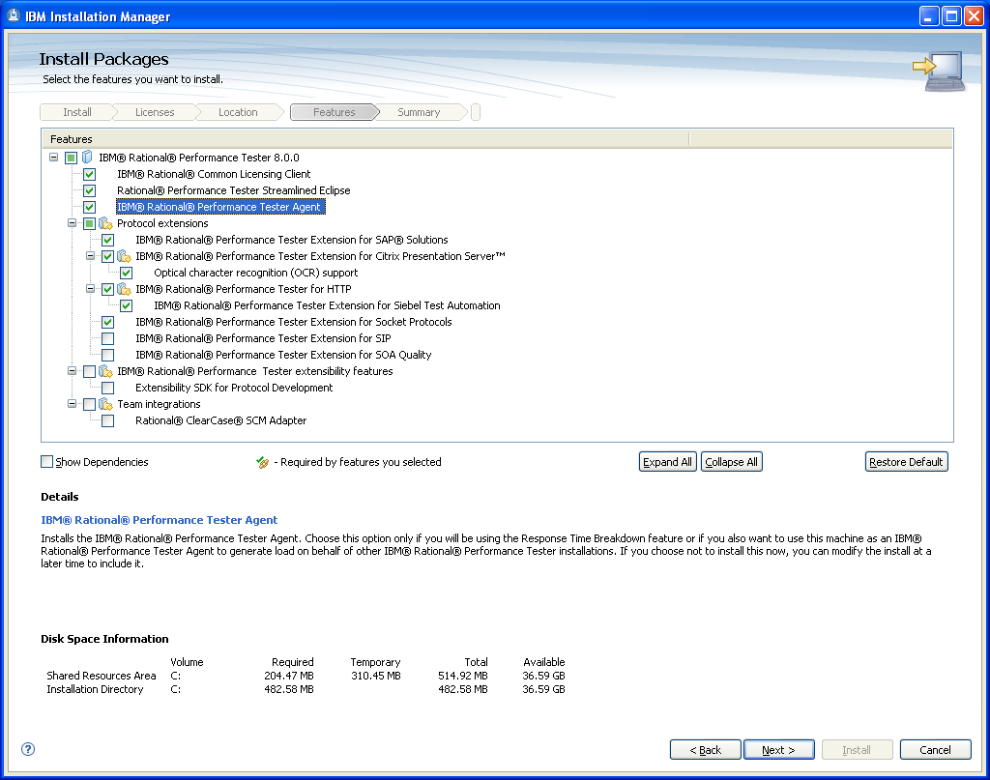
RPT Installation

Slide 60
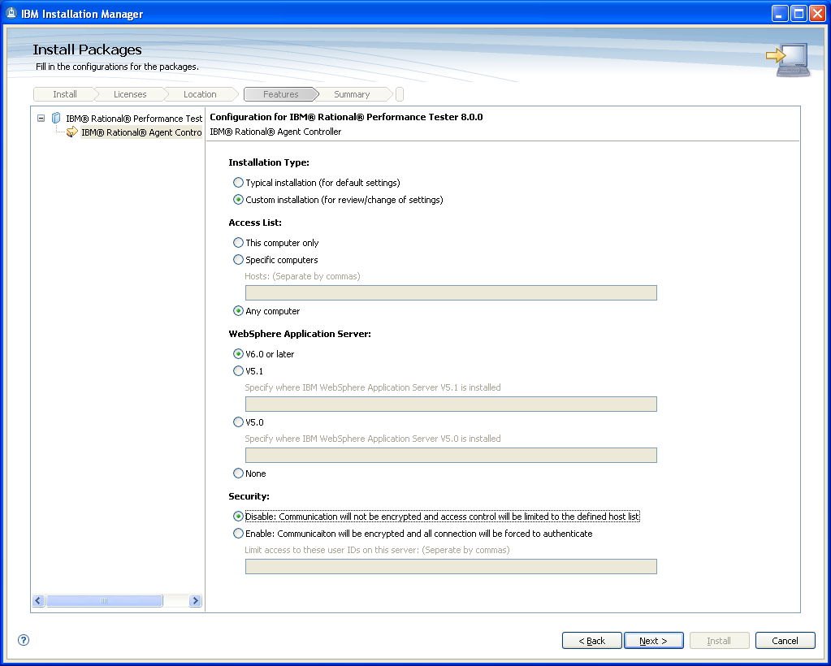
RPT Installation (Cont’d)

Slide 61
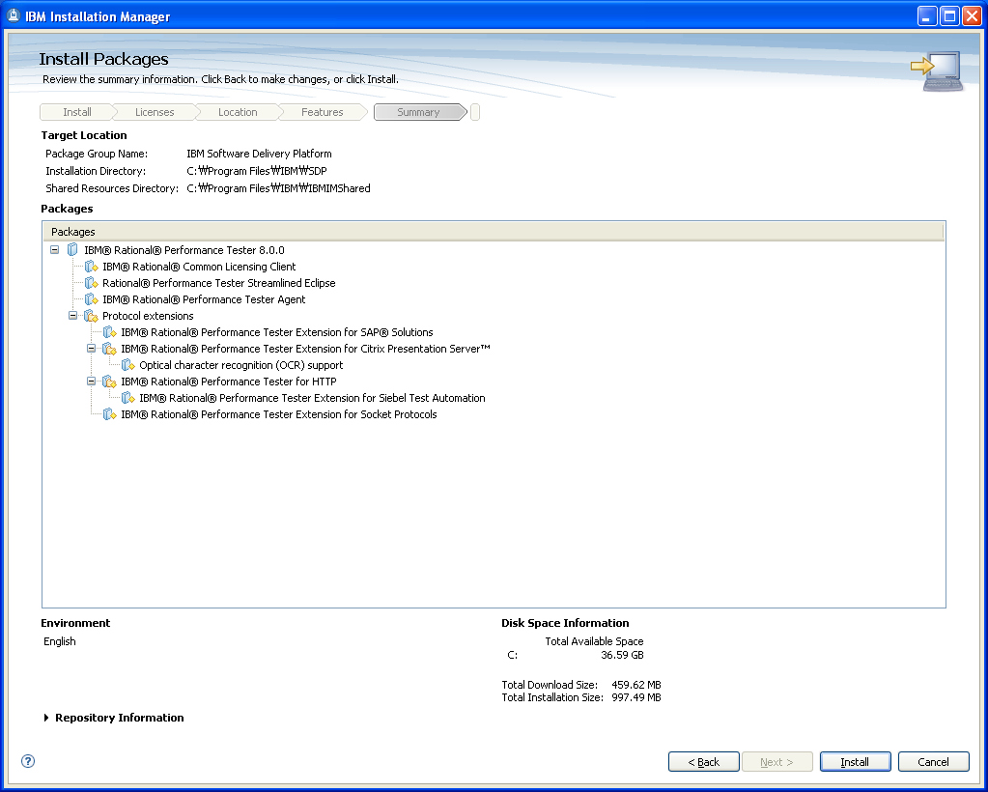
RPT Installation (Cont’d)

Slide 62
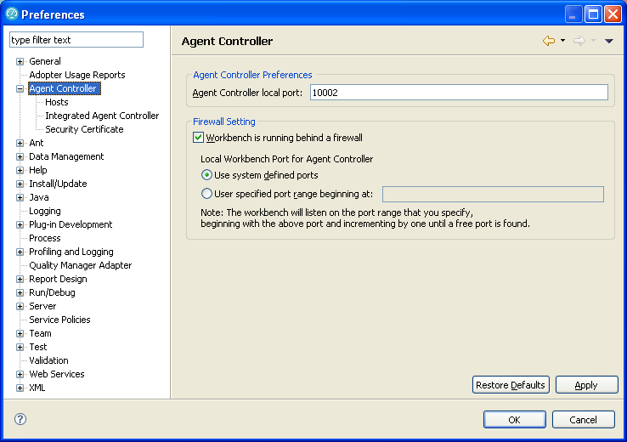
RPT Configuration

Slide 63
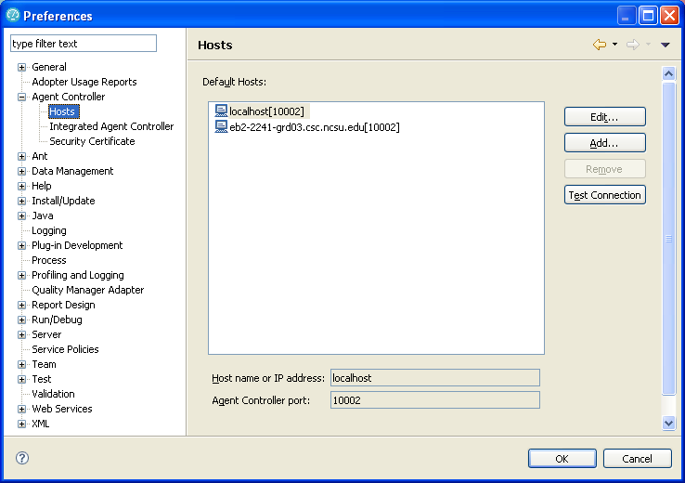
RPT Configuration (Cont’d)

Slide 64
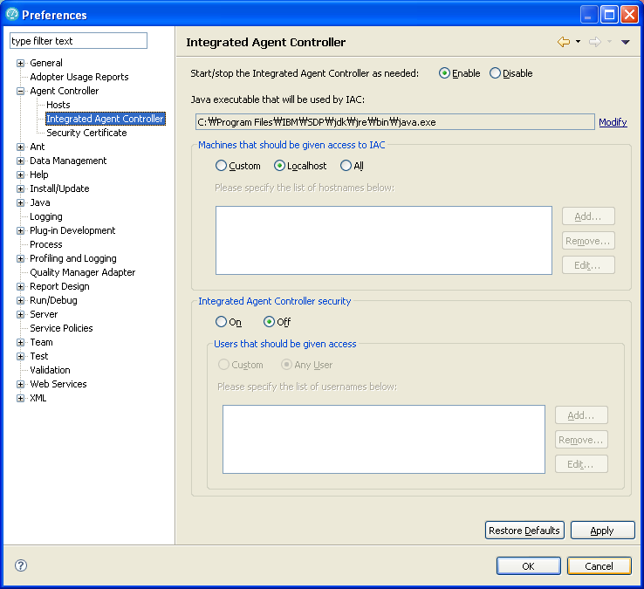
RPT Configuration (Cont’d)

Slide 65
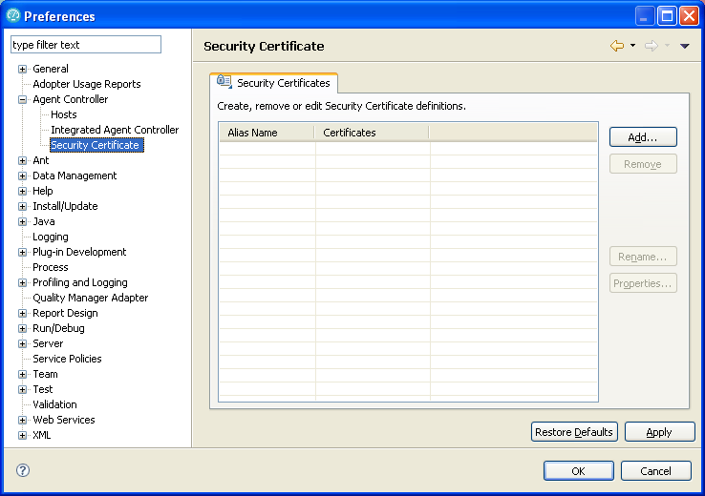
RPT Configuration (Cont’d)

Slide 66
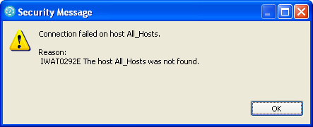
Trouble Shooting
IWAT0292E
http://www.ibm.com/developerworks/forums/message.jspa?messageID=13938063

Slide 67
VNC
Installation and Configuration

Slide 68
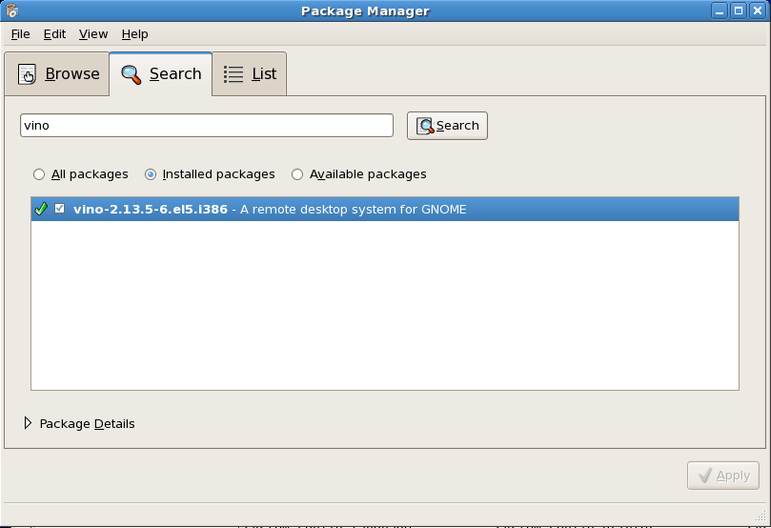
Set up VNC Server
[Applications] –[Add/Remove Software] or #pirut
Check out whether “vino” is installed

Slide 69
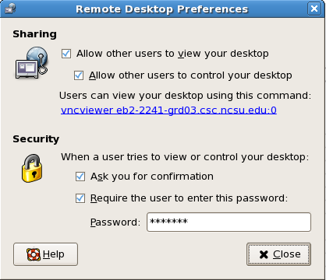
Set up VNC Server (Cont’d)
[System]-[Preferences]-[Remote Desktop]

Slide 70

Connect to eb2-2241-grd03
eb2-2241-grd03.csc.ncsu.edu:0
Start vncserver
#service vncserver start
Register
…

Slide 71
Setting up the server
/etc/sysconfig/vncservers

Slide 72
References
http://kin.naver.com/detail/detail.php?d1id=1&dir_id=10202&docid=7848413&qb=dm5jc2VydmVy&enc=utf8

